Slide 1
Software Testing
Integration Testing (Part 2)
Presented By
Ning Chen, Ph.D.
Professor
Department of Computer
Science
California State University,
Fullerton
© Ning Chen, 2017
*

Slide 2
Module Objectives
This module focuses on the Integration Testing

Slide 3
Call Graph
A Call Graph is a directed graph in which vertices are program units (or methods) and a directed edge joins calling vertex to the called vertex. Note that a call graph is different from a structural graph. An edge in a call graph indeed represents a calling relationship that links one unit to another.

Slide 4
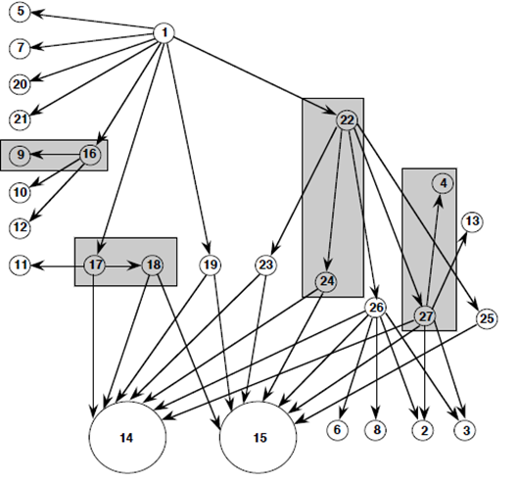
Pair-Wise Call Graph-Based Integration

Slide 5
Continued
The above call graph shows calling relationship among 15 units of program. You only perform the integration testing on a pair of units which has a calling edge from one to another, for example, an integration testing on the pair (unit 9 and unit 16). The motivation is that since unit 9 is available, you don’t need to come up with a test driver stub during the test of unit 16.

Slide 6
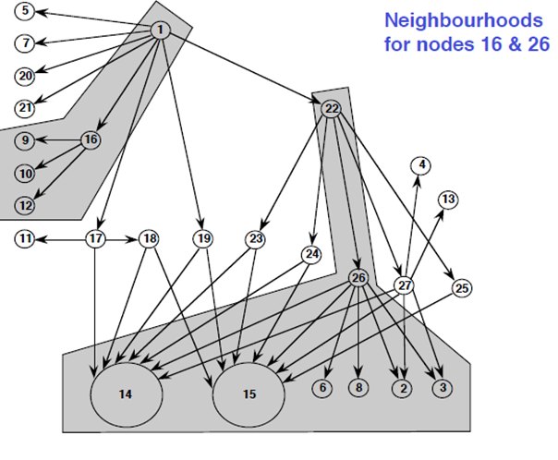
Neighborhood Call Graph-Based Integration Testing

Slide 7
Continued
Another variant of call graph testing is the use of neighborhood concept. The above call graph highlights a neighborhood of unit/node 16 and a neighborhood of unit/node 26. A neighborhood of a given unit/node is the collection of all the units/nodes one edge away from it and itself.
You may want to conduct one integration testing on each neighborhood at a time.

Slide 8
Conducting integration testing by following paths
A call graph shows us a static calling relationship among given units. For example, we use an edge in a call graph to say unit 1 has a source code statement that calls unit 2. At run time, will unit 1 actually call unit 2? Well, it may not, if the call is under a decision statement (e.g., if false, it will not call). This observation opens up the idea of Path-Based Integration Testing. Let’s take a look at a scenario.

Slide 9
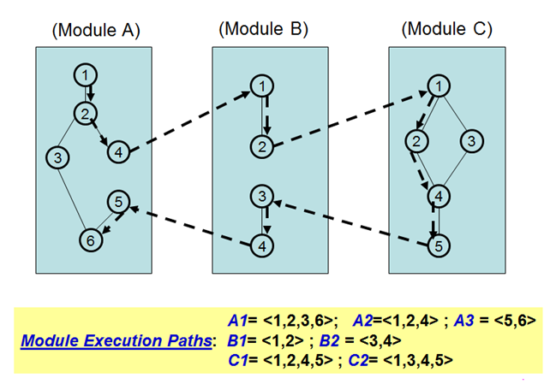
Conducting integration testing by following paths

Slide 10
Continued
The above graph shows three program units or called modules here (A, B and C). The nodes in each unit are program statements. In this example, we assume that in one scenario, the execution starts in Module A (from Node 1 to Node 4), then, calls Module B(from Node 1 to Node 2), then, calls Module C (from Node 1 to Node 5). The return path starts from Module C (Node 5), passing Module B, Node 4, finally ends in Module A Node 6. Why should we pay attention to this long possible execution path? Well, for a tester who conducts an integration test on Modules A , B and C, this path may represent a major feature of the software and for sure, you may want your test case that “walk/pass” through this path. Is this the only path scenario? Certainly not. For example, the execution may start in Module A through Node 1, 2, 3 and 6, which never calls Module B. We name this kind of path that links modules along their messaging (or invocation/calling) mechanism as MM-Path (Module-Message-Path) [Jorgensen].

Slide 11
Continued
If we also label all other possible ordinary paths① in each module, we may end up with the following paths:
A1= a path that goes through Node 1, 2, 3, 6
A2= a path that goes through Node 1, 2, 4
A3= a path that goes through Node 5, 6
B1= a path that goes through Node 1,2
B2= a path that goes through Node 3, 4
C1= a path that goes through Node 1, 2, 4, 5
C2= a path that goes through Node 1, 3, 4, 5

Slide 12
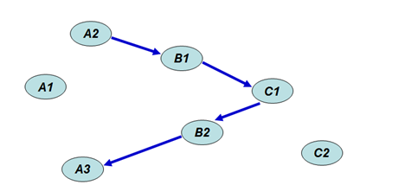
Continued
Using the above possible path notations, we may redraw our original scenario as:

Slide 13
Claim/Rationale
We observe that the MM-Path we discussed before, composes of paths of A2, B1, C1, B2 and A3. Notice that paths A1 and C2 are not touched. In some sense, the MM-Path we identified can be viewed as a slice of all possible paths in the combined modules. Now, you probably can see the key idea (or claim) – if we can find and test all possible MM-Paths, we will be in good shape in terms of integration testing. We prefer to call this approach as MM-Path Path-Based Integration Testing – an awkward and long name, but, at least, we should use it one time.

Slide 14
Side Note
① You may wonder, for instance, why we don’t have a path that goes through Node 1, 2, 4, 5, 6 in Module A? One “on the face” answer is that well, there is no edge that links Node 4 to 5 in our graph. Nevertheless, we soon realize that Node 5 is the next statement of Node 4. In a typical program graph, we should draw an edge from Node 4 to Node 5. Well, in our discussion, we know that Node 4 is a calling statement (it calls Node 1 in Module B). Due to this detour, we really can’t say that we have a direct path from Node 4 to Node 5 in Module A.

Slide 15
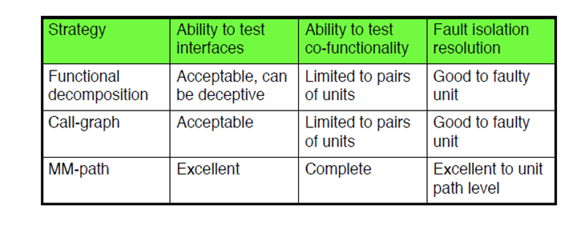
MM-path integration testing compared to other methods

